Slide 1
Winlink Team Production www.winlink.org
Winlink Network for Emergency Communications

Slide 2
What is Winlink?
Winlink is a worldwide radio messaging system that uses radio frequencies to provide services that include email with attachments, HTML templates, position reporting, weather bulletins, emergency relief communications, and message relay
Simply put; it allows you with free software to send and receive traffic with a radio and adequate equipment
It uses both amateur radio band frequencies and commercial channels as well
Hams world wide, military support groups, international organizations, and governments; all use the same network
Volunteer operated with redundancy, many years in operation and a track record of disaster support as a backup system

Slide 3
Winlink in use during Mexico EQ and Puerto Rico Disaster - 2017
Observations from behind the scenes and assistance provided to Amateur radio Emcomm responders for reliable network access
Mike Burton XE2/N6KZB
(assisted by XE2SI)
- Member Winlink Development Team
- Manager of Mexico‵s Winlink gateways

Slide 4
Mexico 7.1 Earthquake September 19-2017
Occurred about 65 KM outside of Mexico City
Hundreds killed and injured with wide spread pockets of damage
Infrastructure down, over loaded, or intermittent
32 years to the day of previous Mexico City 8.1 Earthquake
FMRE activated its Amateur Radio Red Net to include Winlink resources

Slide 5
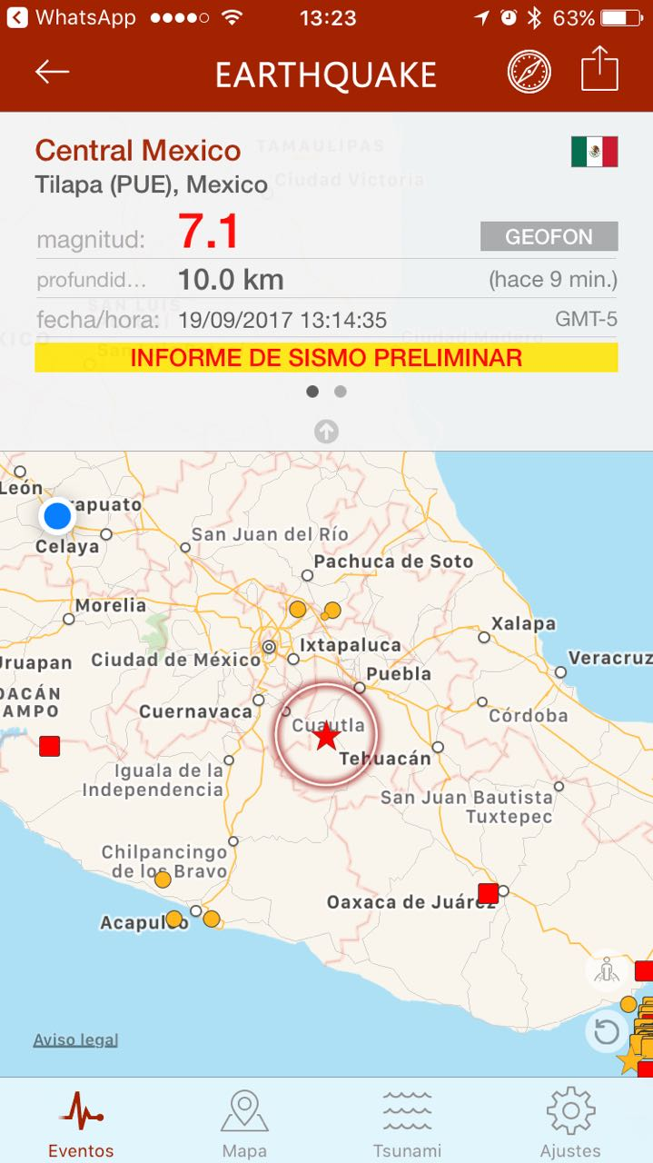

Slide 6
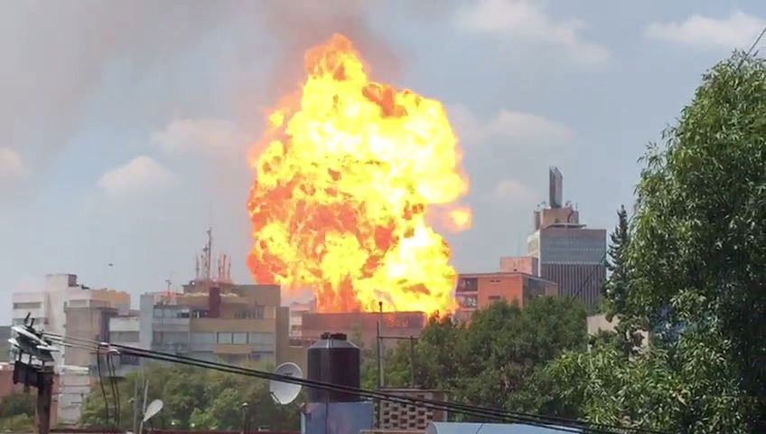

Slide 7
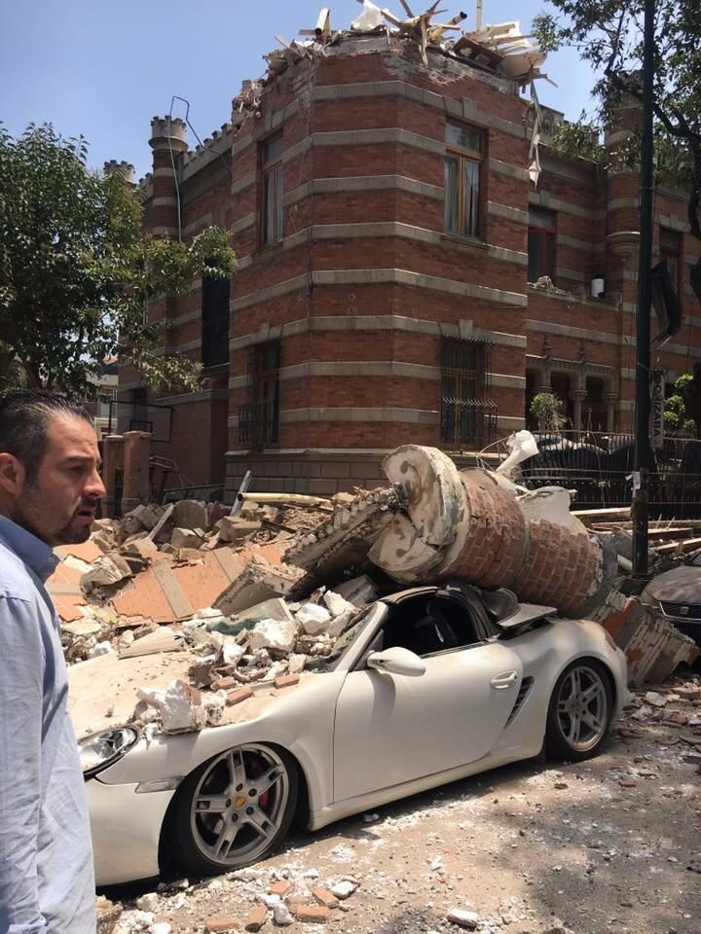
Was a nice car

Slide 8
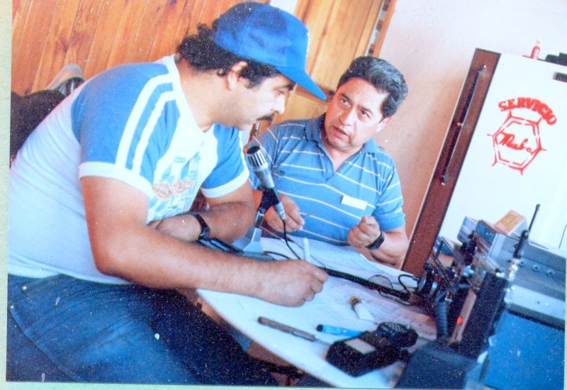
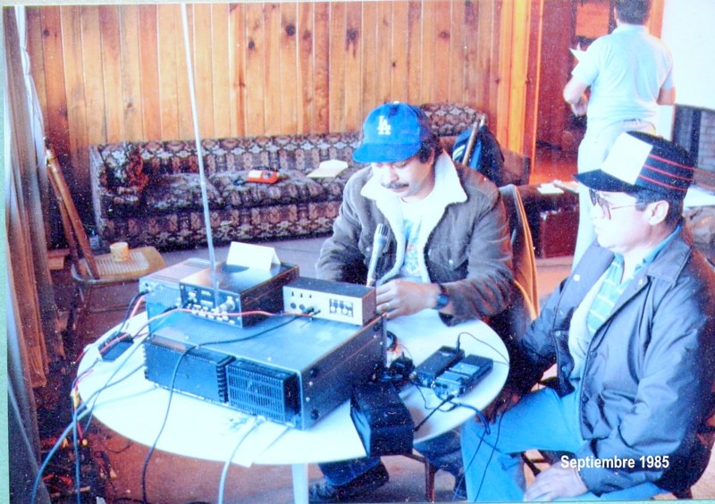
Mexico City 1985 XE2SI & XE2EFR (sk)

Slide 9
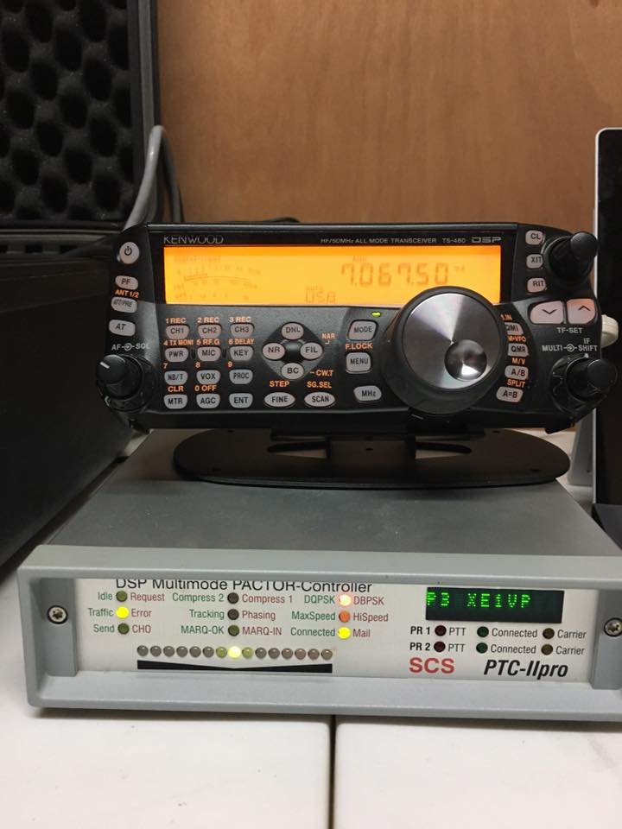
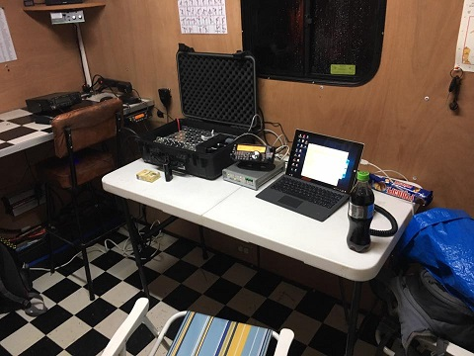
Mexico City 2017 XE1PRA Comm Van

Slide 10
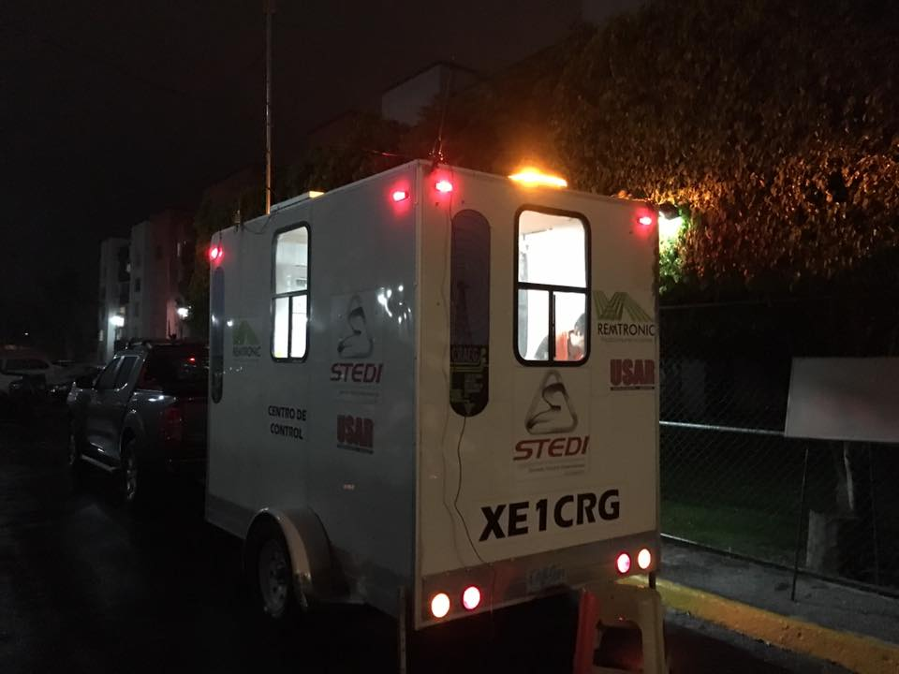
Mobile comm van from radio club XE1CRG in Guanajuato

Slide 11
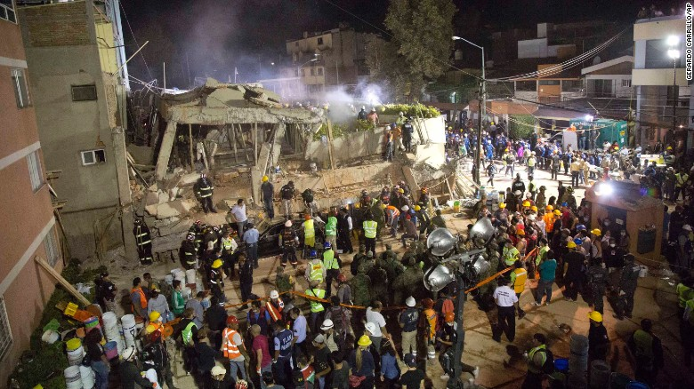
Site of collapsed school that operator XE1PRA used XE1CRG comm van with Pactor for emails

Slide 12
XE1VP gateway Mexico City no internet - forwarding to N5TW in Texas on HF

Slide 13
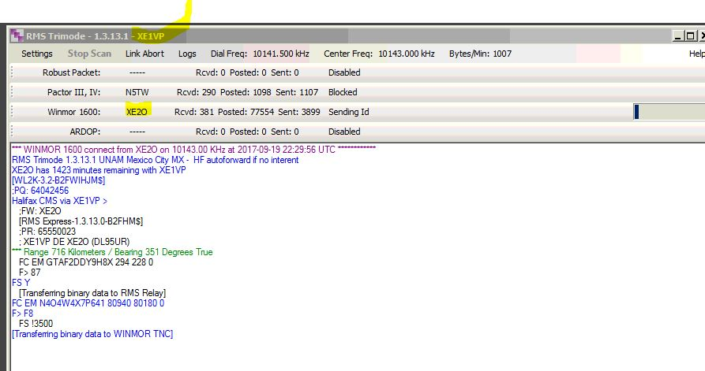
XE2O handling traffic via Winmor

Slide 14
Conclusion to Mexico EQ presentation
Total of 31 messages sent via Winlink system on HF Most via Pactor a few via Winmor [40 and 20 meters]
Average message size 5-7 K
Primary Mexican gateways used: XE1VP in Mexico City and XE3N in Cancun
HF auto-forwarding done on Pactor when needed by XE1VP gateway to N5TW gateway in Texas to borrow its Internet connection
QUESTIONS??

Slide 16
Puerto Rico Disaster Sep/Oct 2017
Early on Wednesday, September 20, Hurricane Maria — a powerful Category 4 hurricane with 150 mph winds — made direct landfall on Puerto Rico, bisecting the entire island and drenching it with enormous amounts of rain
Major destruction and loss of most infrastructure and services

Slide 17
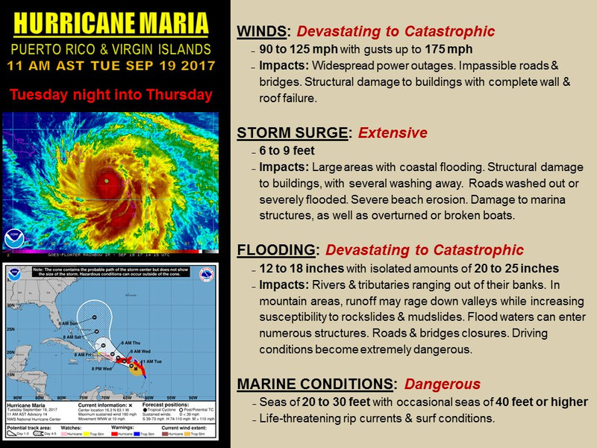

Slide 18
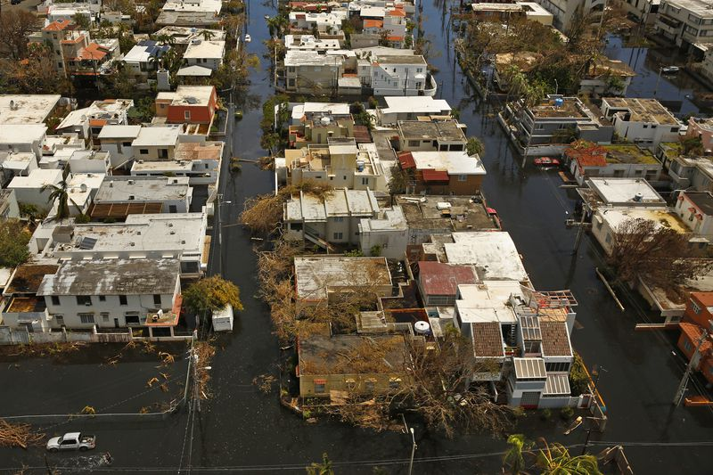
Flooding just one of many problems

Slide 19
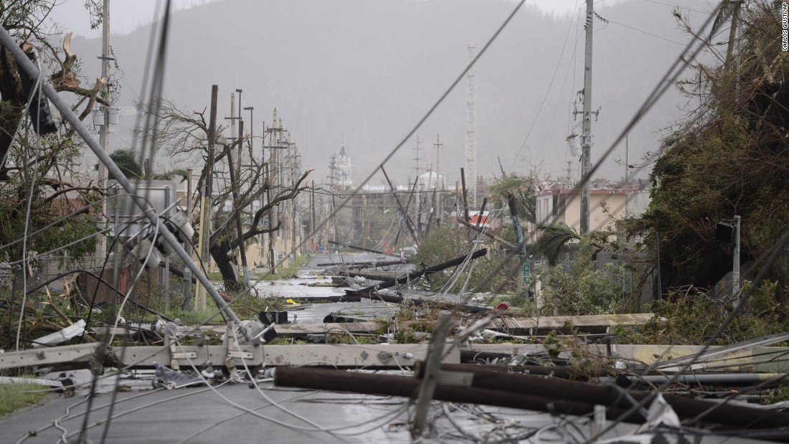
Described as a war zone

Slide 20
With so much infrastrucure damage and communications problems, the Winlink System could assist in out of the area email delivery
- Red Cross needed amateur radio volunteers that were Winlink savvy.
- ARRL assisted in gathering 22 to respond with go-kits
- These kits were mostly Icom 7200, 40 meter dipoles and external tuner.
- Red Cross provided lap tops with Winlink Express
- Teams housed to begin with at fire stations, hospitals, and Govt. facilities

Slide 21
Observations
- Winlink responders were sent with 40 meter only antennas. Can fold to do 20 and use tuner for 17
- No pactor modems were sent, use of Winmor via radio only
- Band conditions & distance, an Achilles heel for Winmor
- First couple of days needed to get routine down
- Use of a tactical call assisted greatly in traffic delivery
- Desire to send a large Red Cross spreadsheet was problematic

Slide 22
Observations 2
- About 7 gateways were reliable to Puerto Rico, one being XE3N in Cancun, mostly 40 and 17 meters
- N5TW was a main connection due to being in Texas with large arrays mostly 40 20 and 17 meters
- FCC authorized P4 but no modems were deployed until Red Cross teams left and SHARES teams arrived
- Seemed to be a lack of coordination with replies
- Some teams began to use HTML templates
- New forms created for event use was distributed

Slide 23
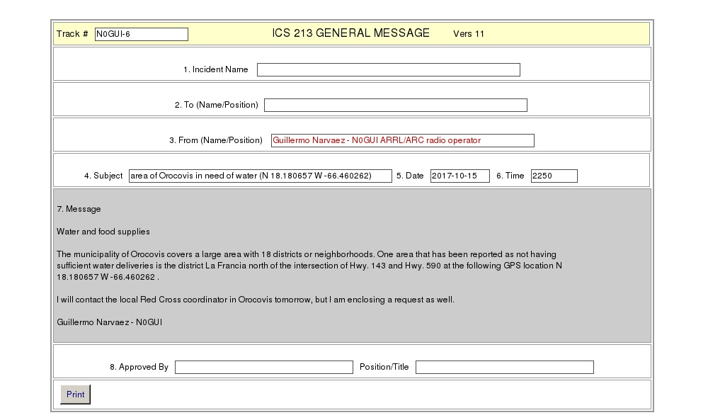
HTML Form ICS 213

Slide 24
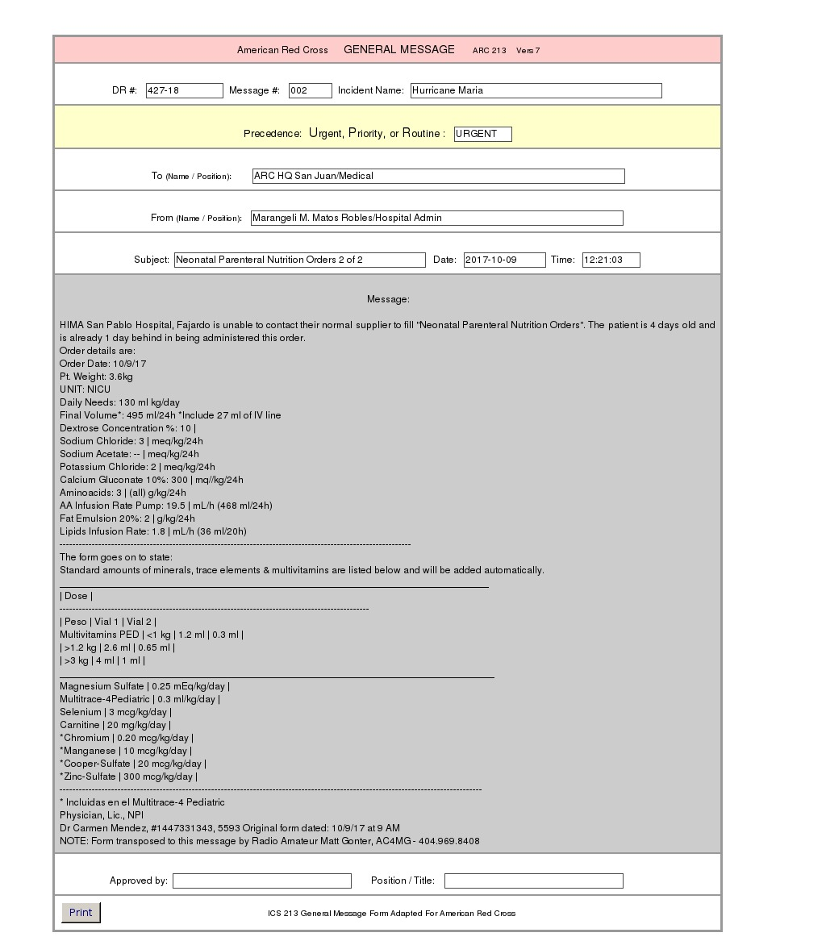

Slide 25
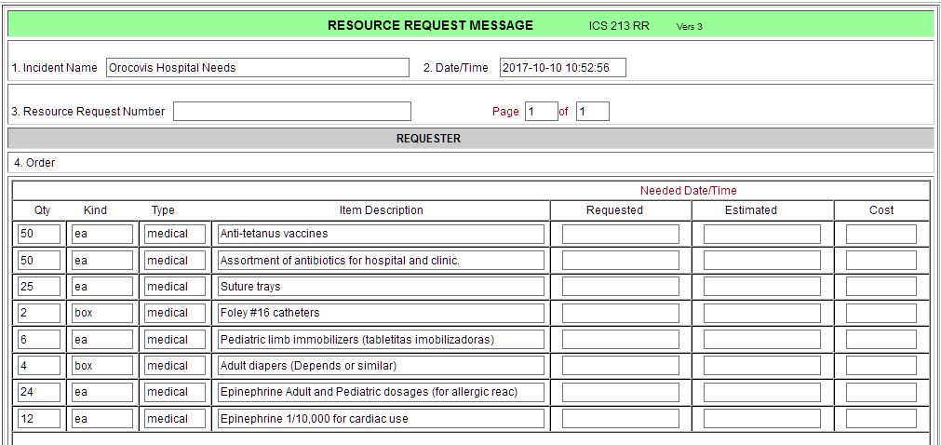
HTML Form ICS 213RR

Slide 26
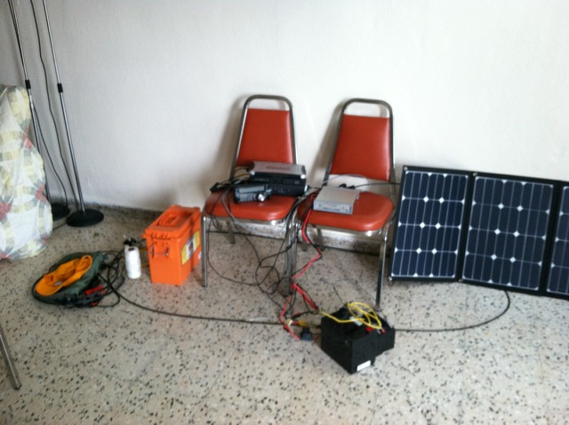
WINLINK SYSTEM IN GUAYAMA, PR. 2017. Kenwood 480H, SCS II USB MODEM, SLA batteries and solar panel

Slide 27
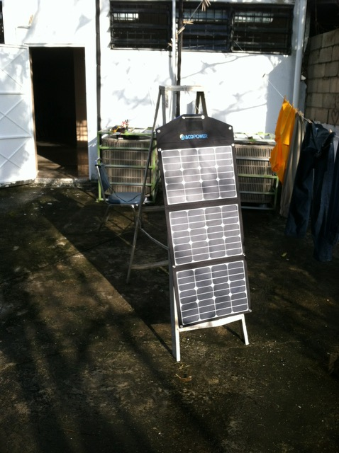
Solar panel erected on rear porch of RAHAM BAPTIST CHURCH, Guayama, PR

Slide 28
Report from Kenny Witt, KC4OJS to Winlink Team
Just wanted to say thanks! Our team recently spent a couple of weeks in Guayama, PR. installing a water purification system for the local community, and setting up a "feeding kitchen" as well.
For the first week and a half, our only means to communicate with our folks back home (or anyone) was with WINLINK.
We had a battery powered HF rig running 20 watts, with a 40/80 trap dipole (flat at 30 feet). Most of the connections were on 12 and 20 meters during the daytime, averaging 1400 miles. We did not operate at night, as we had no commercial power....and to be honest, we were tired and went to bed!
We initially were charging the batteries with a small solar array, but SAMARITANS PURSE came along with a generator permitting the use of a small "battery charger / maintainer" to keep the batteries up.

Slide 29
Message from a SHARES operator using Pactor. Shared Resources (SHARES) High Frequency Radio Program
This message was sent approximately 20 days from Puerto Rico from a SHARES volunteer who had set up a Winlink RMS in the FEMA Joint Field Office.
‶The only stable, consistent comms from here has been HF radio. Because of the extremely high noise level (S9 to S9 +20db ) generated by all the other services, voice SSB communications are almost unusable here. But DATA on Winlink seems to get thru the muck and having the availability of many SHARES Winlink gateways in varied geographical areas is providing the opportunity for a connection under changing propagationconditions.
We've exercised SHARES Winlink email with FEMA down here and we've successfully emailed back & forth between systems. I've educated FEMA I.T. in the Ponce Branch Office (because when people can't send emails, I.T. hears about it first) about how to access us at the SHARES HF station to allow priority emails to be sent. I think Winlink is performing the service it was designed for down here.‶

Slide 30
Conclusion to Winlink and Puerto Rico disaster
- Winlink can provide an out-of-the area email delivery system
- A trained & equipped HF operator can be essential the first few days
- Do not oversell the capabilities as it is a backup system
-Winmor protocol has limitations on distance & band conditions that make Pactor invaluable
-Use of HTML templates in Express reduce operator time & keep consistency in message content
- Hundreds of messages were sent in 3 weeks via HF
- Average message size 2-3 K
QUESTIONS??

